Slide 1
REGULAR EXPRESSIONS IN PYTHON

Slide 2

SESSION TOPICS
Overview
Introduction
Metacharacters
Special Sequences
Functions in RegEx
Modules
Packages
Tasks

Slide 3
INTRODUCTION
A Regular Expression (RegEx) is a sequence of characters that defines a search pattern.
We have a built-in module in python to work with RegEx i.e., re
We have to import that module into our python file by using a keyword called import
Syntax: import re

Slide 4
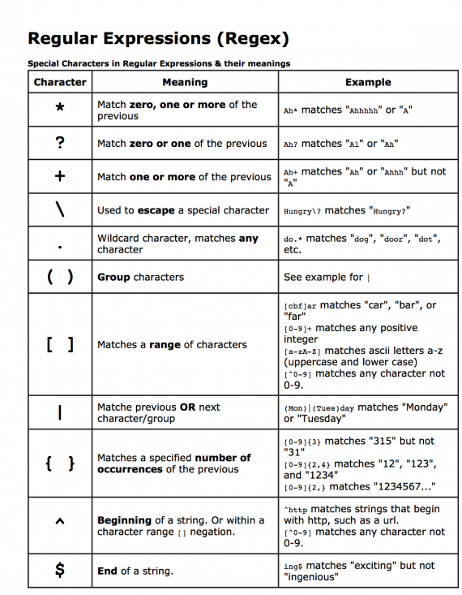
METACHARACTERS
Metacharacters are the special symbols
in RegEx.
- In python we have 11 metacharacters.
which are list below.

Slide 5
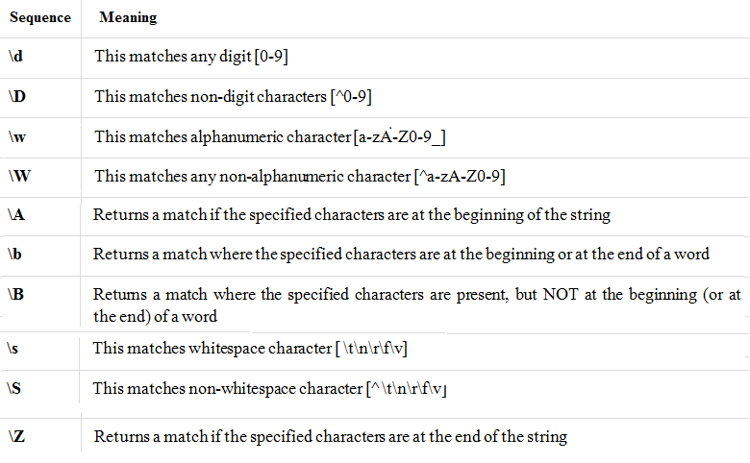
SPECIAL SEQUENCES

Slide 6
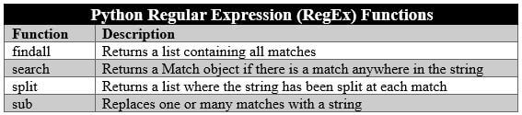
FUNCTIONS IN REGEX

Slide 7
CONTII
findall() : This method returns a list of strings that contains all search patterns. If the pattern is not found then it returns an empty list.
Syntax: re.findall(‘pattern’, string)

Slide 8
CONTII…
search() : This method returns the first occurrence of the matching pattern in a string. If match not found then it returns None.
Syntax: re.search(‘pattern’, string)

Slide 9
CONTII…
split() : This methods splits the string where there is a match and returns a list where the splits have occurred.
Syntax: re.split(‘pattern’, string, max_splits(opt))

Slide 10
CONTII…
sub() : This method returns a string where matched occurrences are replaced with the text which is assigned to replace variable.
Syntax: re.sub(‘pattern’,replace,string, max_replace(opt))

Slide 11
CONTII…
match() : used to search a pattern within the string. It returns a match object if the pattern search is successful if not it returns None.
Syntax: re.match(‘pattern’,string_name or string)

Slide 12
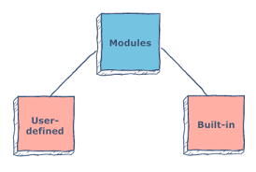
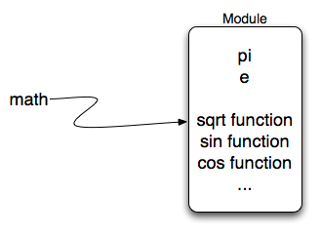
MODULE
Module is a .py file which contains methods or functions. Modules are two types user-defined modules and built-in modules

Slide 13
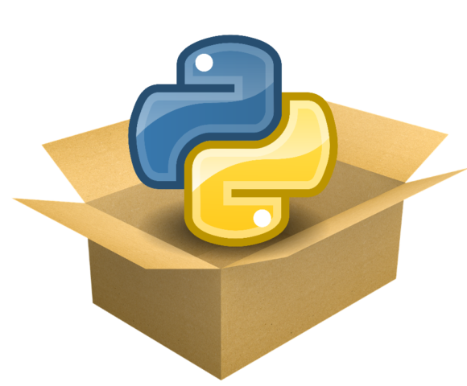

WHAT DO YOU UNDERSTAND BY SEEING THIS PICTURE ?

Slide 14
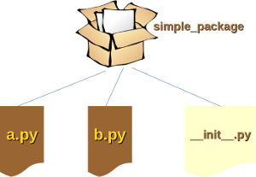
PACKAGE
Package is nothing but a collection of modules which like a folder.

Slide 15
TASKS
Write a Python program to search the numbers (0-9) of length between 2 to 4 in a given string.
Write a Python program that matches a string that has an a followed by zero or one 'b’.
Write a Python program to match if two words from a list of words starting with letter ‘v’.
Write a Python program to replace whitespaces with an hash symbol and vice versa.
Write a Python program to find all words which are at least 4 characters long in a string.

Slide 16


